Slide 1
W3C Web of Things and Geolocation Discovery
Michael McCool
21 July 2022
Presented to W3C SDW IG/WG

Slide 2
Outline
What is WoT?
Applying and extending web standards for IoT
Descriptive interoperability: Thing Descriptions
Recent Activity
Finding Thing Descriptions: Discovery
Discussion
Gaps and Future Work
Geolocation Discovery
Data: Dynamic and Static
Geolocation queries for Discovery
Interval queries on actual data?

Slide 3




W3C Web of Things (WoT)
W3C Working Group goal: Adapting web technologies to IoT
Already published: Thing Description (TD) metadata format
TD describes the available interactions (network API) of a Thing
New deliverables in progress, including Discovery
How does a potential user obtain the TD for a Thing?
App
App
App
App
App
App
WoT API
WoT API
WoT API
{ properties, actions, events }
MQTT
KNX
TLV
ECHONET
Bearer
EXI
HTTP
OAUTH2
WS
XML
MQTT
KNX
TLV
ECHONET
Bearer
EXI
JSON
Modbus
CBOR
OPC-UA
API Key
HTTP
OAUTH2
CBOR
WS
XML
BACnet
AMQP
JSON
Modbus
BACnet
OPC-UA
API Key
AMQP

Slide 4

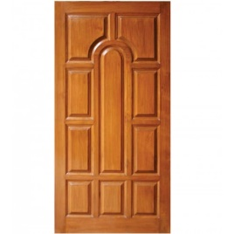

Descriptive Interoperability: TDs
WoT Architecture
Constraints
"Things" must have a TD
Must use URIs, IANA media types, etc.
Thing Description Affordances
Describes WHAT the possible choices are
Describes HOW to interact with the Thing
WoT Thing Description (TD)
{
"@context": [
"https://www.w3.org/2022/wot/td/v1.1",
{ "iot": "http://iotschema.org/" }
],
"id": "urn:dev:org:32473:1234567890",
"title": "MyLEDThing",
"description": "RGB LED torchiere",
"@type": ["Thing", "iot:Light"],
"securityDefinitions": {
"default": {"scheme": "bearer"}
},
"security": ["default"],
"properties": {
"brightness": {
"@type": ["iot:Brightness"],
"type": "integer",
"minimum": 0,
"maximum": 100,
"forms": [ ... ]
}
},
"actions": {
"fadeIn": {
...
Pull
Handle = Affordance
What?
How?
Door = Thing
Open
Turn

Slide 5
Usage Patterns Overview

Slide 6

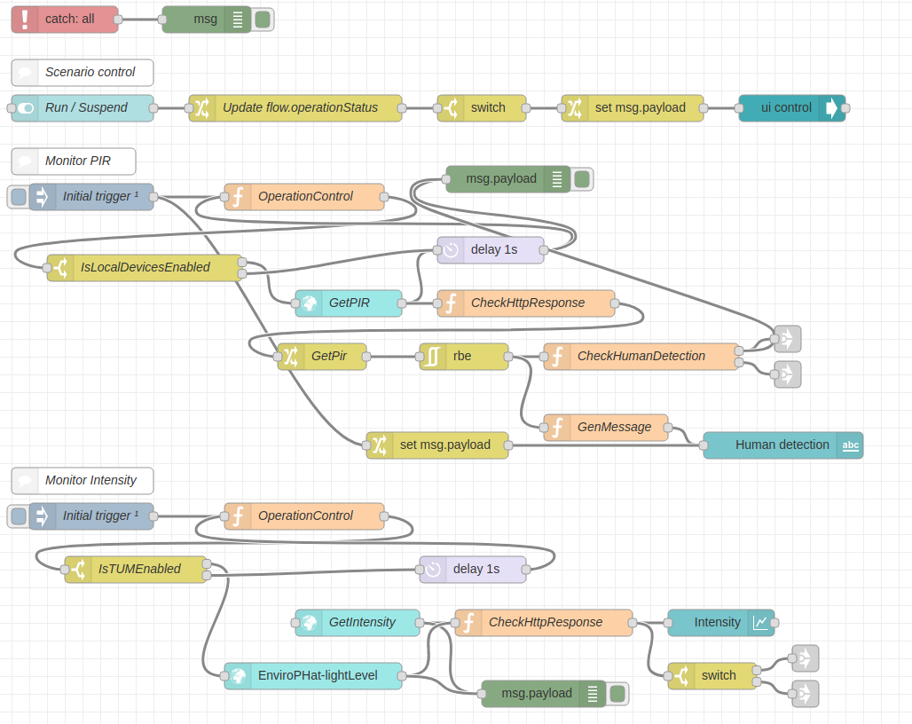
Orchestration
node-wot/Scripting API
WoTHelpers.fetch( "coap://localhost:5683/counter" ).then( async (td) => {
// using await for serial execution (note 'async' in then() of fetch())
try {
const thing = await WoT.consume(td);
console.info( "=== TD ===" );
console.info(td);
console.info( "==========" );
// read property #1
const read1 = await thing.readProperty( "count" );
console.info( "count value is" , await read1.value());
// increment property #1 (without step)
await thing.invokeAction( "increment" );
const inc1 = await thing.readProperty( "count" );
console.info( "count value after increment #1 is" , await inc1.value());
// increment property #2 (with step)
await thing.invokeAction( "increment" , {'step' : 3});
const inc2 = await thing.readProperty( "count" );
console.info( "count value after increment #2 (w/ step 3) is" , await inc2.value());
// decrement property
await thing.invokeAction( "decrement", undefined, {
formIndex: getFormIndexForDecrementWithCoAP(thing);
} );
const dec1 = await thing.readProperty( "count" );
console.info( "count value after decrement is" , await dec1.value());
} catch(err) {
console.error( "Script error:", err);
}
}).catch( (err) => { console.error( "Fetch error:", err); });
Node-RED/node-gen

Slide 7
Use Cases and Requirements
Informative Deliverable: https://github.com/w3c/wot-usecases
Purpose and Process:
Identify specific use cases
Identify application domains
Collect use cases from other W3C groups
Collect use cases from other stakeholders and SDOs
Identify usage patterns
For example, hubs, proxies, automation, etc.
Identify relevant technologies
For example, edge computing, digital twins, etc.
→ Extract common requirements to drive current and future work

Slide 8
Use Cases / Requirements Process
Spec creation (WG)
Use Case TF (IG)
Security
Shortlist
Gaps
TD
Use Case
Use Case
s
Use Case
Requirement
Use Case
Scripting
New Building Block
Discovery
System Architecture / Configuration
Profile
WoT Deliverables

Slide 9
Deliverables
New/Updated Normative Documents:
Architecture 1.1: https://github.com/w3c/wot-architecture
Thing Description 1.1: https://github.com/w3c/wot-thing-description
Discovery: https://github.com/w3c/wot-discovery
Profiles: https://github.com/w3c/wot-profile
New/Updated Informative Documents:
Binding Templates: https://github.com/w3c/wot-binding-templates
Scripting API: https://github.com/w3c/wot-scripting-api
Use Cases and Requirements: https://github.com/w3c/wot-usecases
Community Resources:
Web Site: https://www.w3.org/WoT/

Slide 10
Recent Activity
Commercial Usages related to Geolocation
Takenaka Construction – Smart Building Information Management systems
Netzo – IoT dashboards and device management
Directory Implementations
WoT Hive, LogiLab (SPARQL based), Fraunhofer LinkSmart
IETF Relationships: JSON Path, CoreRD, COSE/JOSE, ASDF
Under Discussion:
Geospatial data, Embedded JSON Signatures
New Charters/New Deliverables

Slide 11


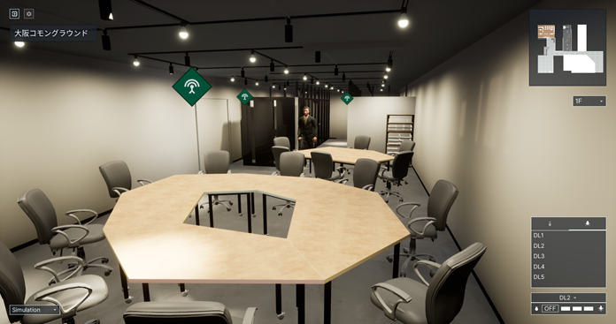
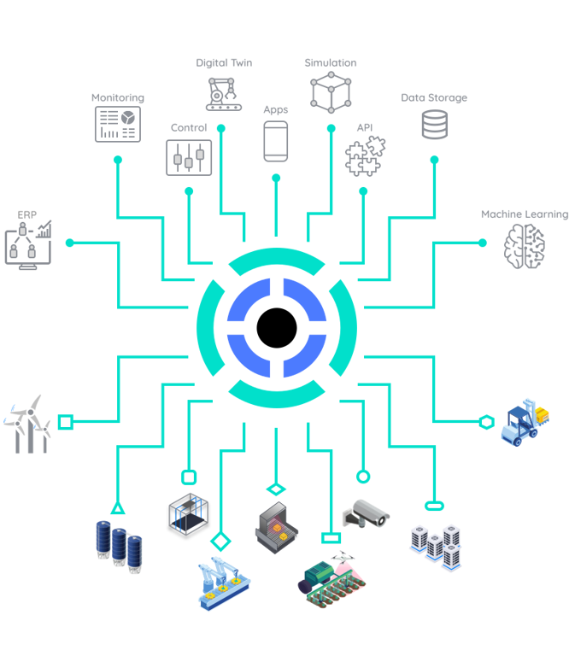
Applications
https://new.siemens.com/global/en/products/buildings/automation/desigo.html
https://www.evosoft.com/en/digitalization-offering/saywot/
Siemens
Desigo CC – BIM
Say WoT!
https://www.takenaka.co.jp/news/2021/05/02/
Takenaka Corporation
CGLL Platform - BIM
https://www.eclipse.org/ditto/2022-03-03-wot-integration.html
Bosch
Eclipse Ditto - Digital twin
https://netzo.io/
Netzo
IoT Data Hub
Dashboards

Slide 12
Gaps and Future Work
GIS Integration
Geospatial data and discovery
Data Management
Digital Twins and shadows
Event notifications
Historical data
Security
Key provisioning and onboarding
Secure LAN access
Proxy services
Access control and ad-hoc sharing
MUDS
Accessibility
Sensory modality mapping
Textual/descriptive interfaces
Service location
Mobility services
Advanced Use Cases
Transportation
Logistics
Distributed energy management
AR visualization
Analytics integration e.g. for health and safety monitoring

Slide 13
Discovery
Goal:
Obtain TD of interest
Not limited to local network
Scalable to many TDs
Need to preserve privacy
Architecture:
Phased access:
Introduction: open
Exploration: controlled access
Introduction mechanisms
Direct, WK, DNS-SD, CoRE-RD, DID
Exploration mechanisms
TD Server, Self, Directory
Directories searchable via
JSON Path (IETF RFC pending)
XPath 3.1
SPARQL

Slide 14
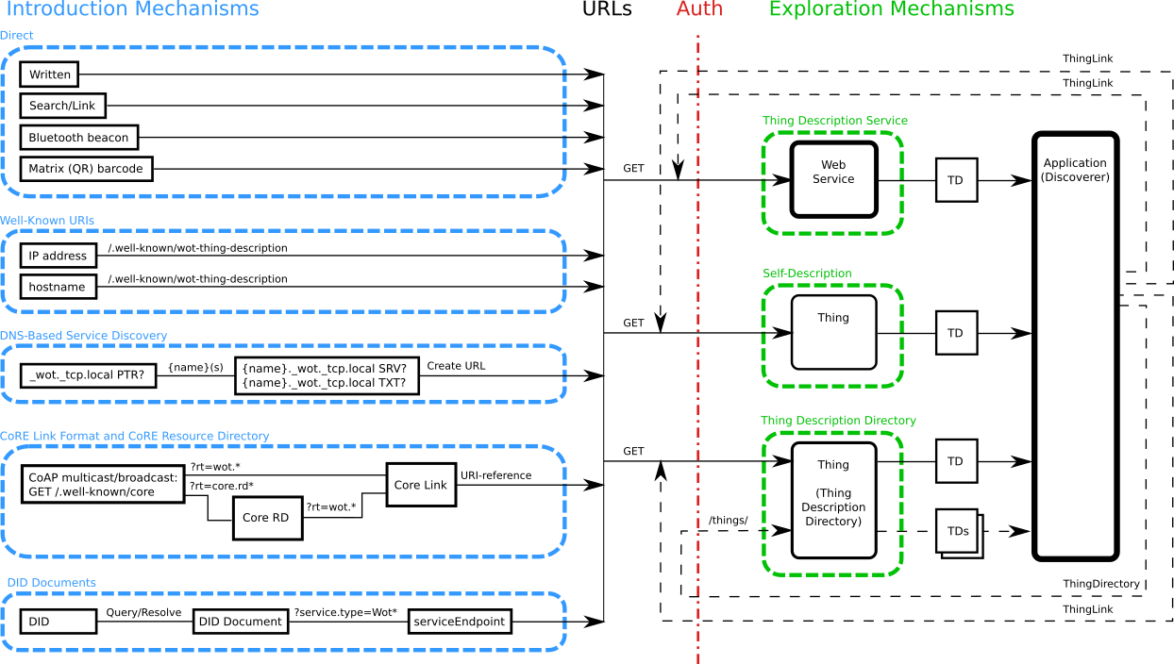
Discovery

Slide 15
Discovery
Possible future work:
Encode static geospatial data in Thing Descriptions
Provide ontologies for dynamic geospatial data
Index Things by location in TD Directories
Provide geolocation filters in Introduction mechanisms
e.g. geolocation filters in DNS-SD
Discover Things using geospatial queries
"find all Things within 100m of lat 49.2803175 long -123.1286623"
"find all HVAC sensors in Room 101 of Sheraton Wall Vancouver"
Both "quantitative" and "qualitative" locations important
Also store sensor data and search based on interval queries
See:
Geolocation proposal and examples
Discussion of next WoT charter

Slide 16
Example TDs using Geolocation
Simple static installation, using schema.org
Static installation, using modular (proposed) geolocation ontology
Dynamic installation, using internal geolocation resource
Dynamic installation, using separate geolocation service
Dynamic installation, geolocation service
Discovery extensions:
Spatially-aware introduction mechanisms (e.g. ext. DNS-SD or DID)
Query mechanisms for Directories (GeoSPARQL and/or JSONPath ext.)

Slide 17
Resources and Contacts
https://www.w3.org/WoT
Dr. Michael McCool
Principal Engineer
Intel
Technology Pathfinding
michael.mccool@intel.com
Dr. Sebastian Kaebisch
Senior Key Expert
Siemens
Technology
sebastian.kaebisch@siemens.com

